Slide 1
The Adverse Childhood Experiences (ACE) Study

Slide 2
The Adverse Childhood
Experiences (ACE) Study
The largest study of its kind ever done to examine the health and social effects of adverse childhood experiences over the lifespan (18,000 participants)
The ACE study is ongoing collaborative research between the Centers for Disease Control and Prevention in Atlanta, GA and Kaiser Permanente in San Diego, CA.

Slide 3
Background
The Co-principal Investigators of the Study are Robert F. Anda, MD, MS with the CDC; and Vincent J. Felitti, MD, with Kaiser Permanente
Over 17,000 Kaiser patients participating in routine health screening volunteered to participate in The Study.
Data resulting from their participation continues to be analyzed; it reveals staggering proof of the health, social, and economic risks that result from childhood trauma.

Slide 4


What do we mean by Adverse Childhood Experiences?
Experiences that represent medical and
social problems of national importance
childhood abuse and neglect
growing up with domestic violence
substance abuse or mental illness in the home
parental loss
crime
Notes:
Traumatic life experiences during childhood and adolescence have now been recognized in medical practice and public health
In the context of everyday medical practice, it has been recognized that the earliest years of infancy and childhood are not lost but, like a child’s footprints in wet cement, are often life-long

Slide 5
ACE Study Design
Survey Wave 1 - complete
71% response (9,508/13,454)
n=15,000
71% response
Mortality
National Death Index
Morbidity
Hospital Discharge
Outpatient Visits
Emergency Room Visits
Pharmacy Utilization
All medical evaluations
abstracted
Present
vs.
Health Status
Survey Wave II
n=15,000
All medical evaluations
abstracted
Notes:
This slide presents the ACE study design. It is formatted into three sections.
The first section presents information about the surveys. Survey Wave 1 is complete. Out of a population of 15,000 people, 13,454 were contacted and 9,508 responded. This is a 71 percent response rate. All medical evaluations were abstracted.
Survey Wave 2 also has a sample size of 15,000. Medical evaluations are being abstracted.
The second section states the study is examining the present health status of the participants.
The third section indicates the study further examines mortality with National Death Index data as well as morbidity from data on hospital discharge, outpatient visits, emergency room visits, and pharmacy utilization.

Slide 6

The Adverse Childhood Experiences (ACE) Study
Summary of Findings:
Adverse Childhood Experiences (ACEs) are very common
ACES are strong predictors of later health risks and disease
This combination makes ACEs the leading determinant of the health and social well-being of our nation
Notes:
Childhood abuse, neglect, and exposure to other traumatic stressors which we term adverse childhood experiences (ACE) are common. Almost two-thirds of our study participants reported at least one ACE, and more than one of five reported three or more ACE. The short- and long-term outcomes of these childhood exposures include a multitude of health and social problems

Slide 7
The ACE Pyramid
Social, Emotional, and Cognitive Impairment
Disrupted Neurodevelopment
Adverse Childhood Experiences
Early
Death
Disease, Disability, and Social Problems
Adoption of Health-risk Behaviors
Death
Conception
Mechanisms by Which Adverse Childhood Experiences Influence
Health and Well-being Throughout the Lifespan

Slide 8
Categories of Adverse Childhood Experiences
Category
Prevalence (%)
Abuse, by Category
Psychological (by parents) 11%
Physical (by parents) 11%
Sexual (anyone) 22%
Household Dysfunction, by Category
Substance Abuse 26%
Mental Illness 19%
Mother Treated Violently 13%
Imprisoned Household Member 3%

Slide 9
Abuse
Emotional Abuse
Physical Abuse
Sexual Abuse
Notes:
Prevalence information is organized by three major ACE categories: abuse, neglect, and household dysfunction
Each category is further divided into multiple subcategories.
Participant demographic information is available by gender, race, age, and education
Prevalence of Individual Adverse Childhood Experiences
ACE Study Participant Demographic
The following categories all occurred in the participant's first 18 years of life
Abuse
Emotional Abuse
Often or very often a parent or other adult in the household swore at you, insulted you, or put you down and sometimes, often or very often acted in a way that made you think that you might be physically hurt
Physical Abuse
Sometimes, often, or very often pushed, grabbed, slapped, or had something thrown at you or ever hit you so hard that you had marks or were injured
Sexual Abuse
An adult or person at least 5 years older ever touched or fondled you in a sexual way, or had you touch their body in a sexual way, or attempted oral, anal, or vaginal intercourse with you or actually had oral, anal, or vaginal intercourse with you

Slide 10
Neglect
Emotional Neglect
Physical Neglect
Notes:
Neglect (Collected during the second survey wave only (N=8,667)
Emotional Neglect Respondents were asked whether their family made them feel special, loved, and if their family was a source of strength, support, and protection. Emotional neglect was defined using scale scores that represent moderate to extreme exposure on the Emotional Neglect subscale of the Childhood Trauma Questionnaire (CTQ) short form
Physical Neglect
Respondents were asked whether there was enough to eat, if their parents drinking interfered with their care, if they ever wore dirty clothes, and if there was someone to take them to the doctor. Physical neglect was defined using scale scores that represent moderate to extreme exposure on the Physical Neglect subscale of the Childhood Trauma Questionnaire (CTQ) short form constituted physical neglect

Slide 11
Household Dysfunction
Mother Treated Violently
Household Substance Abuse
Household Mental Illness
Parental Separation or Divorce
Incarcerated Household Member
Notes:
Household Dysfunction
Mother Treated Violently
Your mother or stepmother was sometimes, often, or very often pushed, grabbed, slapped, or had something thrown at her and/or sometimes often, or very often kicked, bitten, hit with a fist, or hit with something hard, or ever repeatedly hit over at least a few minutes or ever threatened or hurt by a knife or gun
Household Substance Abuse
Lived with anyone who was a problem drinker or alcoholic or lived with anyone who used street drugs
Household Mental Illness
A household member was depressed or mentally ill or a household member attempted suicide
Parental Separation or Divorce
Parents were ever separated or divorced
Incarcerated Household Member
A household member went to prison

Slide 12

Adverse Childhood Experiences Score
ACE score | Prevalence
0 | 48%
1 | 25%
2 | 13%
3 | 7%
4 or more | 7%
Notes:
A total of 52% have at least one ACE
If one ACE is present, the ACE Score is likely to range from 2.4 to 4 depending on the severity of the ACE

Slide 13
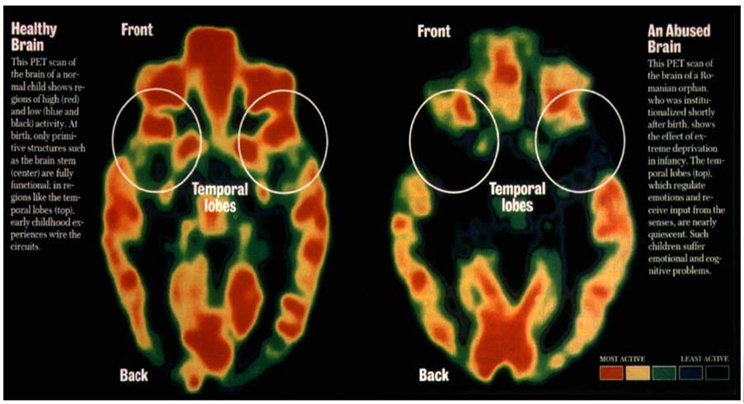
Notes:
This slide shows positron emission tomography (PET) scan graphics of the temporal lobes in a healthy and abused brain.
Healthy brain: this PET scan of the brain of a normal child shows regions of high (shown in red) and low (shown in blue and black) activity. At birth, only primitive structures such as the brain stem (in the center of the brain graphic) are fully functional; in regions like the temporal lobes (at the top of the graphic), early childhood experiences wire the circuits.
Abused brain: this PET scan of the brain of a Romanian orphan, who was institutionalized shortly after birth, shows the effect of extreme deprivation in infancy. The temporal lobes (at the top of the graphic), which regulate emotions and receive input from the senses, are nearly quiescent. Such children suffer emotional and cognitive problems.

Slide 14
Health risks Associated with High ACE Scores
Alcoholism and alcohol abuse
Chronic obstructive pulmonary
disease
Depression
Fetal death
Health-related quality of life
Illicit drug use
Ischemic heart disease
Liver disease
Risk for intimate partner violence
Multiple sexual partners
Sexually transmitted infections
Smoking
Suicide attempts
Unintended pregnancies
Early initiation of smoking
Early initiation of sexual activity
Adolescent pregnancy
Notes:
The ACE Study uses the ACE Score, which is a count of the total number of ACE respondents reported.
The ACE Score is used to assess the total amount of stress during childhood and has demonstrated that as the number of ACE increase, the risk for these health problems increases in a strong and graded fashion.
Prevalence of Individual Adverse Childhood Experiences
Collected between 1995 and 1997, the prevalence presented here are estimated from the entire ACE Study sample (n=17,337)
Individual research papers that use only Wave 1 data or Wave 2 data will contain slightly but not significantly different prevalence estimates for individual ACE

Slide 15
ACE and Top Ten Health Risks in U.S.
Smoking
Severe Obesity
Physical Inactivity
Depression
Suicide Attempt
Alcoholism
Illicit Drug Use
Injected Drug Use
50+ Sexual Partners
History of STDs
Notes:
Adverse Childhood Experiences determine the likelihood of the ten most common causes of death in the United States
With an ACE Score of 0, the majority of adults have few, if any, risk factors for these diseases
However, with an ACE Score of 4 or more, the majority of adults have multiple risk factors for these diseases or have the diseases themselves
Many chronic diseases in adults are determined decades earlier, in childhood
The risk factors underlying these adult diseases are effective coping devices
What is conventionally viewed as a problem is actually a solution to an unrecognized prior adversity
Dismissing them as “bad habits” or “self-destructive behavior” totally misses their function
Premature mortality and excess morbidity are typically the result of a small number of common diseases

Slide 16
ACE Scores and Ischemic Heart Disease

Slide 17

ACE Scores and Smoking Rates

Slide 18
ACE Scores and Smoking Rates
Notes:
This slide is a bar chart representing ACE scores and smoking rates
ACE Score Percentage
0 5.5
1 6
2 8
3 10
4 to 5 12
6 or more 16

Slide 19
ACE Scores, Smoking and COPD
Notes:
This slide has a bar graph titled ACE score versus smoking and COPD (chronic obstructive pulmonary disease).
ACE Score Regular smoking by age 14 COPD
(percent with problem) (percent with problem)
0 3.9 6.9
1 4.2 8.2
2 7.1 11.1
3 7.8 15.5
4 or more 12.3 17.5

Slide 20
ACE and The Weight Program
The Weight Program - exploring reasons underlying the high prevalence of patients inexplicably fleeing their own success
Recognizing that weight loss is often sexually or physically threatening
More public health problems like obesity were also unconscious, or occasionally conscious, compensatory behaviors
Put in place as solutions to problems dating back to the earliest years but hidden by time, by shame, secrecy, and social taboos

Slide 21


ACE and Depression
Some say depression is genetic
Some say depression is due to a chemical imbalance
Might depression be a normal response to
abnormal life experiences

Slide 22
ACE Score and Chronic Depression
Notes:
This slide contains a bar graph titled childhood experiences underlie chronic depression with statistics on the percentage of women and men with a lifetime history of depression.
ACE Score Percentage of Women Percentage of Men
0 18 11
1 24 19
2 35 25
3 42 30
Greater than or equal to 4 58 35

Slide 23
ACE Scores and Suicide Attempts
Notes:
ACE Score Percent attempting suicide
0 1.4
1 2.6
2 4.8
3 10.7
4 or more 19.3

Slide 24

ACE Score, Sexual Partners, STIs, and Unplanned Pregnancy

Slide 25
ACE Score, Sexual Partners, Marriage History and Unplanned Pregnancy
*Adjusted Odds Ratio

Slide 26
ACE Score and Sexual Partners
Notes:
This slide is a bar graph titled adverse childhood experiences versus likelihood of more than 50 sexual partners.
ACE Score Adjusted Odds Ratio
0 1
1 1.7
2 2.3
3 3.1
4 or more 3.2

Slide 27
ACE Score and STI’s
Notes:
This slide contains a bar graph titled adverse childhood experiences versus history of STD (sexually transmitted disease).
ACE Score Adjusted Odds Ratio
0 1
1 1.45
2 1.5
3 1.9
4 or more 2.5

Slide 28
ACE Score and Occurrence of Rape
Notes:
This slide is a bar chart titled childhood experiences underlie rape and presents the ACE scores and percentage of people reporting rape.
ACE Score Percent reporting rape
0 4.7
1 10.2
2 16.5
3 18.4
4 or more 32.1

Slide 29
ACE Score, Intimate Partner Violence, and Rape
*Adjusted Odds Ratio

Slide 30

ACE Score and Addiction

Slide 31
ACE Score, Alcoholism, Drug Abuse, and Suicide
*Adjusted Odds Ratio

Slide 32
ACE Score and Adult Alcoholism
4+
3
2
1
0
Notes:
This slide is a bar chart titled child experiences versus adult alcoholism.
ACE score Percent alcoholic
0 2.8
1 5.7
2 10.3
3 11.4
4 or more 16.1

Slide 33
ACE Score and Intravenous Drug Use
N = 8,022 p<0.001
Notes:
This slide is a bar graph titled ACE score versus intravenous drug use. It presents ACE scores and the percent of people who had injected drugs. The population size is 8,022 and the confidence level is less than .001.
ACE Score Percent that have injected drugs
0 .3
1 .5
2 1.4
3 2.3
4 or more 3.4

Slide 34
ACE Score and Hallucinations
Abused
Alcohol
or Drugs
Ever Hallucinated* (%)
ACE Score
*Adjusted for age, sex, race, and education.
Notes:
It presents the ACE scores of people who had abused alcohol or drugs and people who had not and the percent of each who had ever hallucinated. (Adjusted for age, sex, race, and education.)
ACE Score Percentage of not ever hallucinated Percentage of ever hallucinated
0 1.2 2.7
1 1.2 2.8
2 2 3.1
3 2.1 4.3
4 1.1 4.8
5 1.9 6.1
6 3.4 7.1
Greater than or equal to 7 8.9 10.1

Slide 35
Estimates of the Population Attributable Risk* of ACEs for Selected Outcomes in Women
*That portion of a condition attributable to specific risk factors

Slide 36
Estimates of the Population Attributable Risk* of ACEs for Selected Outcomes in Women
*That portion of a condition attributable to specific risk factors

Slide 37
Estimates of the Population Attributable Risk* of ACEs for Selected Outcomes in Women
*That portion of a condition attributable to specific risk factors

Slide 38
ACE and Serious Job Problems
Notes:
Much of what causes time to be lost from work is actually predetermined decades earlier by the adverse experiences of childhood
This slide is a bar graph titled ACE score versus serious job problems.
ACE Score Percent with Job Problems
0 7.5
1 10.4
2 14.4
3 16.7
4 or more 17.8

Slide 39

Finding Your ACE Score
Let’s
At Our Handout

Slide 40
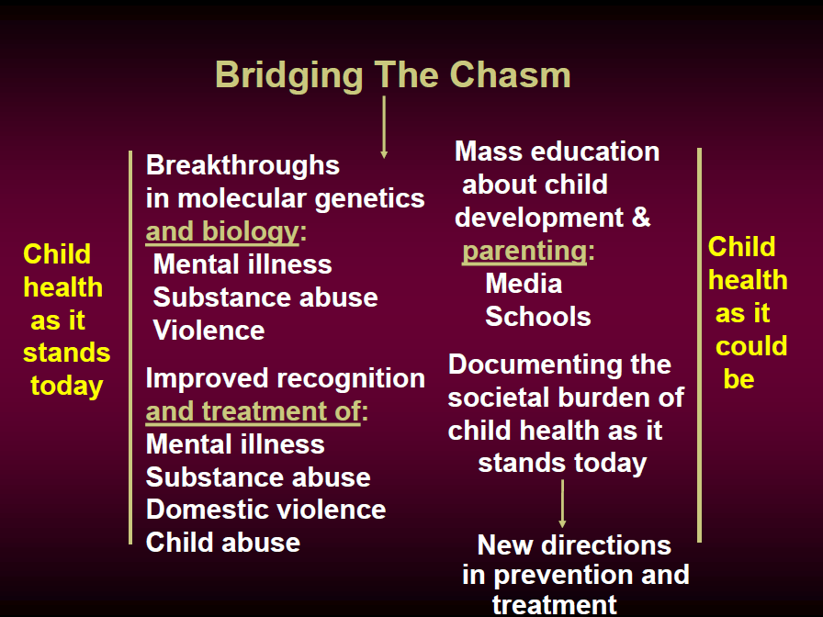

Slide 42
Summary
Adverse childhood experiences are the most basic cause of health risk behaviors, morbidity, disability, mortality, and healthcare costs
The findings from the ACE study provide a remarkable insight into how we become what we are as individuals and as a nation
They are important medically, socially, and economically. Indeed, they have given us reason to reconsider the very structure of medical, public health, and social services in America

Slide 43
Summary
The influence of childhood experience, including often-unrecognized traumatic events, is as powerful as Freud and his colleagues originally described it to be
In spite of these findings the bio-psychosocial model and the bio-medical model of psychiatry remain at odds rather than taking advantage of the new discoveries

Slide 44
What Can We Do Now
Routinely seek history of adverse childhood experiences from all patients
Acknowledge their reality by asking, “How has this affected you later in life”
Arrange a return appointment to discuss possibilities for helping them

Slide 45
THANK YOU!
STAR Health
Behavioral Health Service Management
Physical Health Service Management
Member Services
866-912-6283

